Slide 1
MARKOV Chain – Probability Transition Matrix
ANAND PAUL
Kyungpook national University,
Daegu south korea

Slide 2
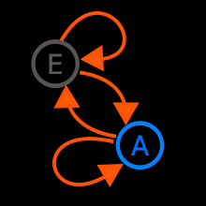
Markov process
Stochastic process
– Movement through a series of well-defined states in a way that involves some elements of randomness
-- for understanding lets say it as “states”
Markov Process – Stochastic process that has no memory -- Selection of next state depends only on current state, and not on prior states -- Process is fully defined by a set of transition probabilities

Slide 3
MARKOV PROCESS
A stochastic process has the Markov property if the conditional probability distribution of future states of the process (conditional on both past and present states) depends only upon the present state, not on the sequence of events that preceded it. A process with this property is called a Markov process.

Slide 4
EXAMPLE
Assume that an urn contains two red balls and one green ball. One ball was drawn yesterday, one ball was drawn today, and the final ball will be drawn tomorrow. All of the draws are "without replacement".
Suppose you know that today's ball was red, but you have no information about yesterday's ball. The chance that tomorrow's ball will be red is 1/2. That's because the only two remaining outcomes for this random experiment are:
Day | Outcome 1 | Outcome 2
Yesterday | Red | Green
Today | Red | Red
Tomorrow | Green | Red
On the other hand, if you know that both today and yesterday's balls were red, then you are guaranteed to get a green ball tomorrow.

Slide 5
This discrepancy shows that the probability distribution for tomorrow's color depends not only on the present value, but is also affected by information about the past. This stochastic process of observed colors doesn't have the Markov property. Using the same experiment above, if sampling "without replacement" is changed to sampling "with replacement," the process of observed colors will have the Markov property.

Slide 6
In discrete time, the process is known as a discrete-time Markov chain (DTMC). It undergoes transitions from one state to another on a state space, with the probability distribution of the next state depending only on the current state and not on the sequence of events that preceded it.
In continuous time, the process is known as a Continuous-time Markov chain (CTMC or continuous-time Markov process^{[2]}). It takes values in some state space and the time spent in each state takes non-negative real values and has an exponential distribution. Future behavior of the model (both remaining time in current state and next state) depends only on the current state of the model and not on historical behavior

Slide 7
Markov Process
Suppose that we perform, one after the other, a sequence of experiments that have the same set of outcomes. If the probabilities of the various outcomes of the current experiment depend (at most) on the outcome of the preceding experiment, then we call the sequence a Markov process.

Slide 8
Example Markov Process
A particular utility stock is very stable and, in the short run, the probability that it increases or decreases in price depends only on the result of the preceding day's trading. The price of the stock is observed at 4 P.M. each day and is recorded as "increased," "decreased," or "unchanged." The sequence of observations forms a Markov process.

Slide 9
States
The experiments of a Markov process are performed at regular time intervals and have the same set of outcomes. These outcomes are called states, and the outcome of the current experiment is referred to as the current state of the process. The states are represented as column matrices.

Slide 10
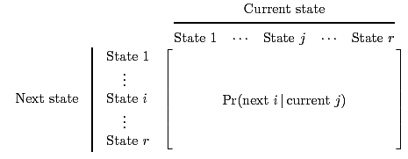
Transition Matrix
The transition matrix records all data about transitions from one state to the other. The form of a general transition matrix is
.

Slide 11
Stochastic Matrix
A stochastic matrix is any square matrix that satisfies the following two properties:
1. All entries are greater than or equal to 0;
2. The sum of the entries in each column is 1.
All transition matrices are stochastic matrices.

Slide 12
Example Transition Matrix
For the utility stock of the previous example, if the stock increases one day, the probability that on the next day it increases is .3, remains unchanged .2 and decreases .5. If the stock is unchanged one day, the probability that on the next day it increases is .6, remains unchanged .1, and decreases .3. If the stock decreases one day, the probability that it increases the next day is .3, is unchanged .4, decreases .3. Find the transition matrix.

Slide 13

Example Transition Matrix (2)
The Markov process has three states: "increases," "unchanged," and "decreases."
The transitions from the first state ("increases") to the other states are

Slide 14


Example Transition Matrix (3)
The transitions from the other two states are

Slide 15
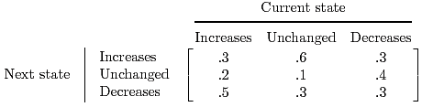
Example Transition Matrix (4)
Putting this information into a single matrix so that each column of the matrix records the information about transitions from one particular state is the transition matrix.

Slide 16
Distribution Matrix
The matrix that represents a particular state is called a distribution matrix.
Whenever a Markov process applies to a group with members in r possible states, a distribution matrix for n is a column matrix whose entries give the percentages of members in each of the r states after n time periods.

Slide 17
Example Distribution Matrix for n
Census studies from the 1960s reveal that in the US 80% of the daughters of working women also work and that 30% of daughters of nonworking women work. Assume that this trend remains unchanged from one generation to the next. If 40% of women worked in 1960, determine the percentage of working women in each of the next two generations.

Slide 18
Example Distribution Matrix for n (2)
There are two states, "work" and "don't work."
The first column of the transition matrix corresponds to transitions from "work".
The probability that a daughter from this state "works" is .8 and "doesn't work" is 1 - .8 = .2.
Similarly, the daughter from the "don't work" state "works" with probability .3 and "doesn't work" with probability .7.

Slide 19

Example Distribution Matrix for n (3)
The transition matrix is
.
The initial distribution is

Slide 20
Example Distribution Matrix for n (4)
In one generation,
So 50% women work and 50% don't work.
For the second generation,
So 55% women work and 45% don't work.

Slide 21
Interpretation of the Entries of A^{n}
The entry in the i^{th} row and j^{th} column of the matrix A^{n} is the probability of the transition from state j to state i after n periods.

Slide 22
Example Interpretation of the Entries
Interpret
from the last example.
If a woman works, the probability that her granddaughter will work is .7 and not work is .3.
If a woman does not work, the probability that her granddaughter will work is .45 and not work is .55.

Slide 23
A Markov process is a sequence of experiments performed at regular time intervals involving states. As a result of each experiment, transitions between states occur with probabilities given by a matrix called the transition matrix. The ij^{th} entry in the transition matrix is the conditional probability

Slide 24
A stochastic matrix is a square matrix for which every entry is greater than or equal to 0 and the sum of the entries in each column is 1. Every transition matrix is a stochastic matrix.
The n^{th} distribution matrix gives the percentage of members in each state after n time periods.

Slide 25
A^{n} is obtained by multiplying together n copies of A. Its ij^{th} entry is the conditional probability Pr(moving to state i after n time periods | in state j). Also, A^{n} times the initial distribution matrix gives the n^{th} distribution matrix.

Slide 26
Specifying a Markov Chain We describe a Markov chain as follows: We have a set of states, S = {s1, s2,...,sr}. The process starts in one of these states and moves successively from one state to another. Each move is called a step. If the chain is currently in state si, then it moves to state sj at the next step with a probability denoted by pij , and this probability does not depend upon which states the chain was in before the current state.

Slide 27
The probabilities pij are called transition probabilities. The process can remain in the state it is in, and this occurs with probability pii. An initial probability distribution, defined on S, specifies the starting state. Usually this is done by specifying a particular state as the starting state. R. A. Howard provides us with a picturesque description of a Markov chain as a frog jumping on a set of lily pads. The frog starts on one of the pads and then jumps from lily pad to lily pad with the appropriate transition probabilities.
A frog hops about on 7 lily pads. The numbers next to arrows show the probabilities with which, at the next jump, he jumps to a neighboring lily pad (and when out-going probabilities sum to less than 1 he stays where he is with the remaining probability).

Slide 28
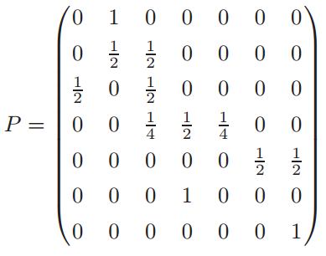
There are 7 ‘states’ (lily pads). In matrix P the element p57 (= 1/2) is the probability that, when starting in state 5, the next jump takes the frog to state 7. We would like to know where do we go, how long does it take to get there, and what happens in the long run? Specifically:

Slide 29
(a) Starting in state 1, what is the probability that we are still in state 1 after 3 steps? (p ₁₁ ⁽³⁾ = 1/4) after 5 steps? (p ₁₁ ⁽⁵⁾ = 3/16) or after 1000 steps? (≈ 1/5 as lim_{n→∞} p ₁₁ ^{(n)} = 1/5)
(b) Starting in state 4, what is the probability that we ever reach state 7? (1/3)
(c) Starting in state 4, how long on average does it take to reach either 3 or 7? (11/3)
(d) Starting in state 2, what is the long-run proportion of time spent in state 3? (2/5)
Markov chains models/methods are useful in answering questions such as: How long does it take to shuffle deck of cards? How likely is a queue to overflow its buffer? How long does it take for a knight making random moves on a chessboard to return to his initial square (answer 168, if starting in a corner, 42 if starting near the centre). What do the hyperlinks between web pages say about their relative popularities?

Slide 30
Example problems – to be solved in the class

